Slide 1

Thinking differently about Impact (AISES course)
creating competative EU-proposal
Danielle de Boer
danielle@innofius.com
https://www.linkedin.com/in/danielledeboer/

Slide 2



Slide 3
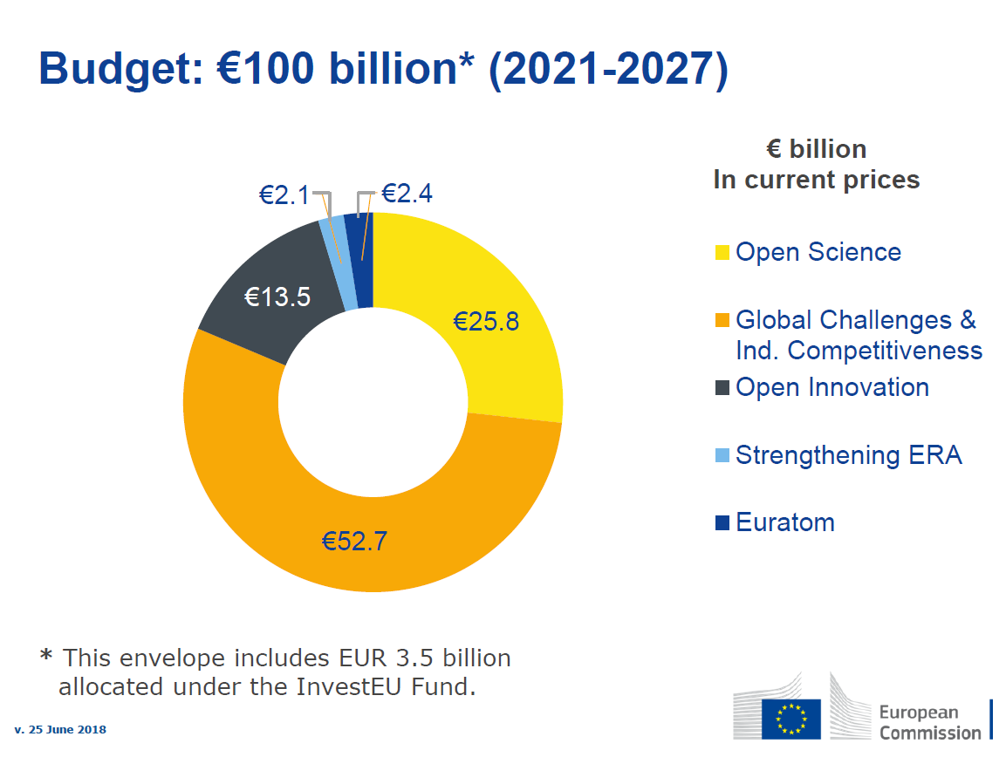

Slide 4
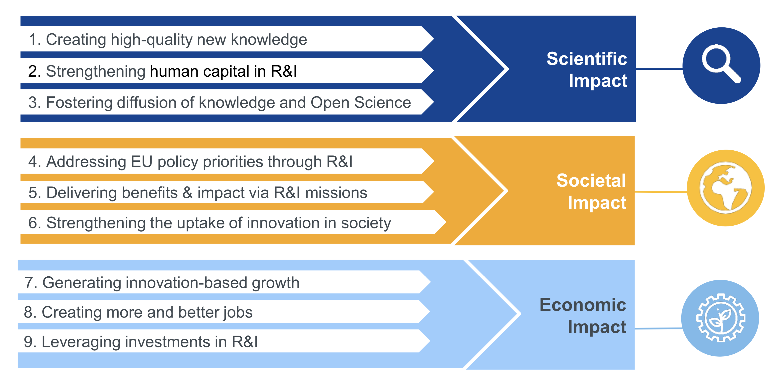

Slide 5

Sustainable Development Goals
Notes:
Horizon Europe, and in particular its second Pillar, will help create a sustainable future where Europeans are healthier and more prosperous and live in a fair and inclusive society that achieves environmental sustainability and respects planetary boundaries

Slide 6
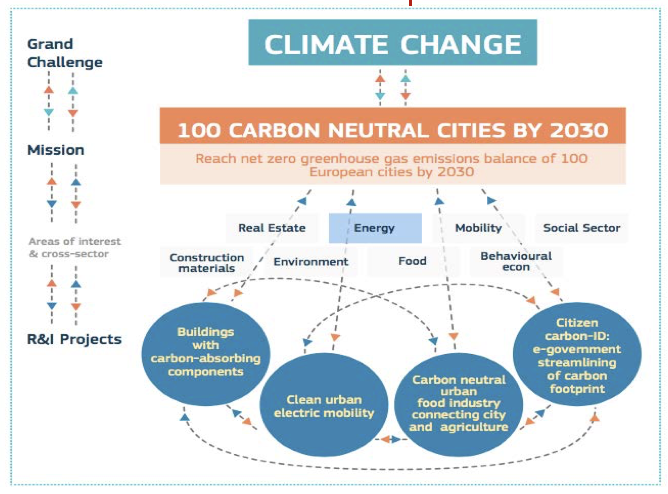
Desired impact = set up missions
Notes:
https://ec.europa.eu/info/sites/info/files/research_and_innovation/strategy_on_research_and_innovation/documents/ec_rtd_he-co-design-activities-report_102019_.pdf

Slide 7
Desired impact = budget
Notes:
https://ec.europa.eu/info/sites/info/files/research_and_innovation/strategy_on_research_and_innovation/documents/ec_rtd_he-co-design-activities-report_102019_.pdf

Slide 8
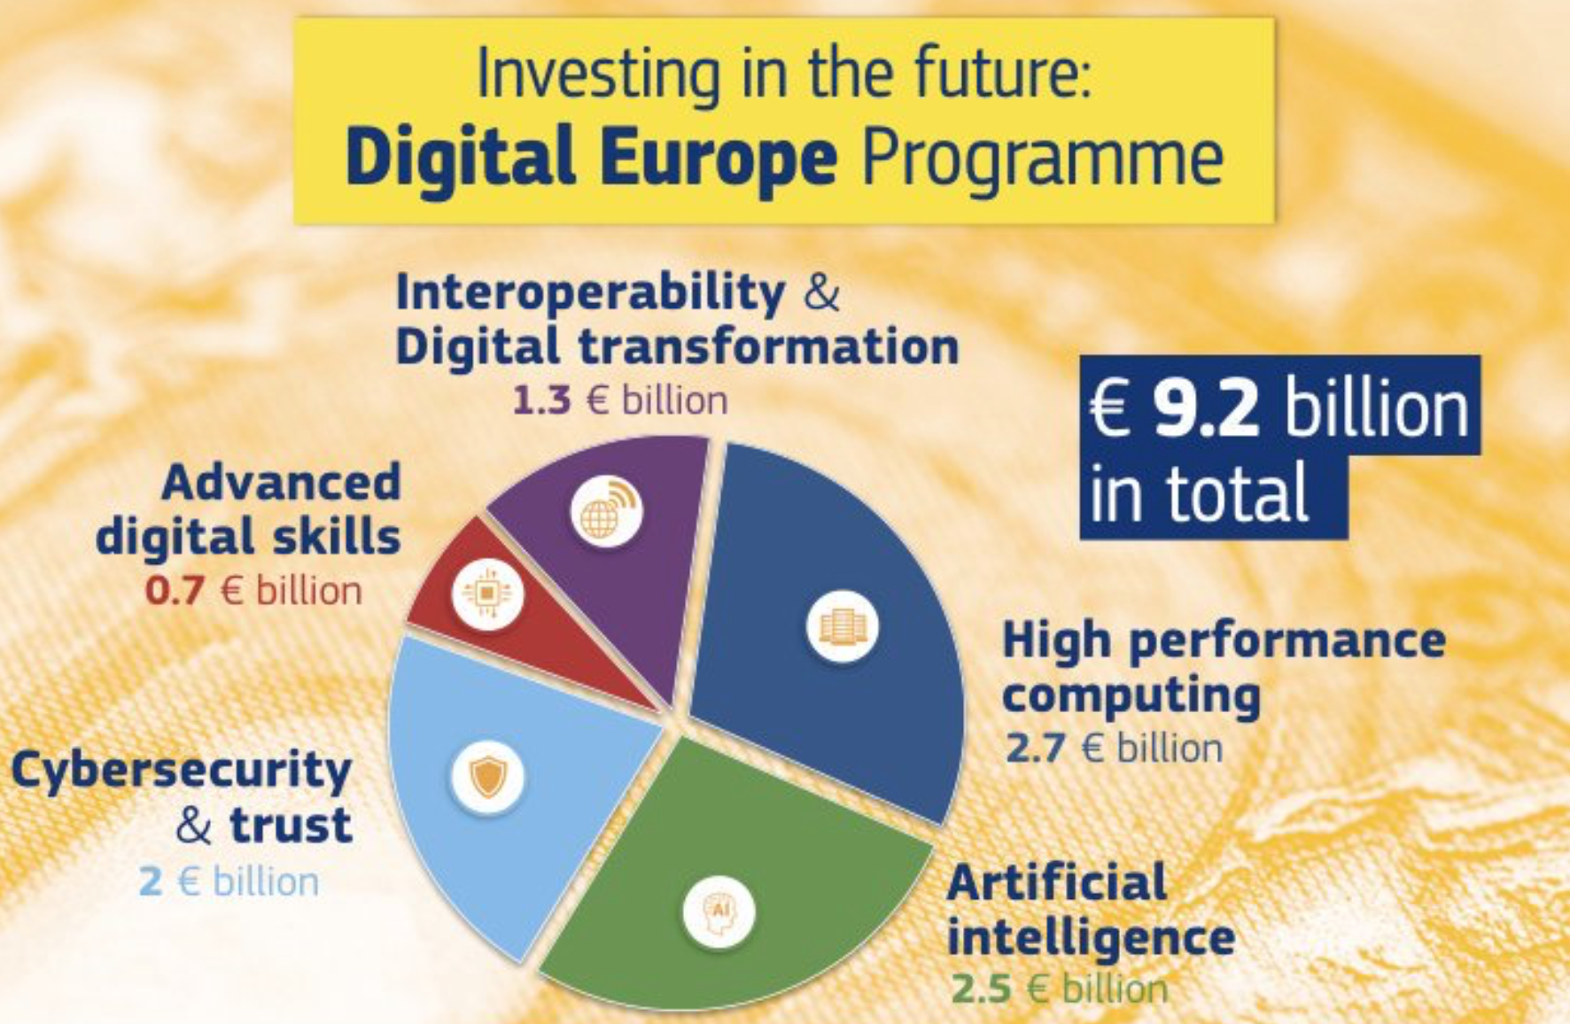
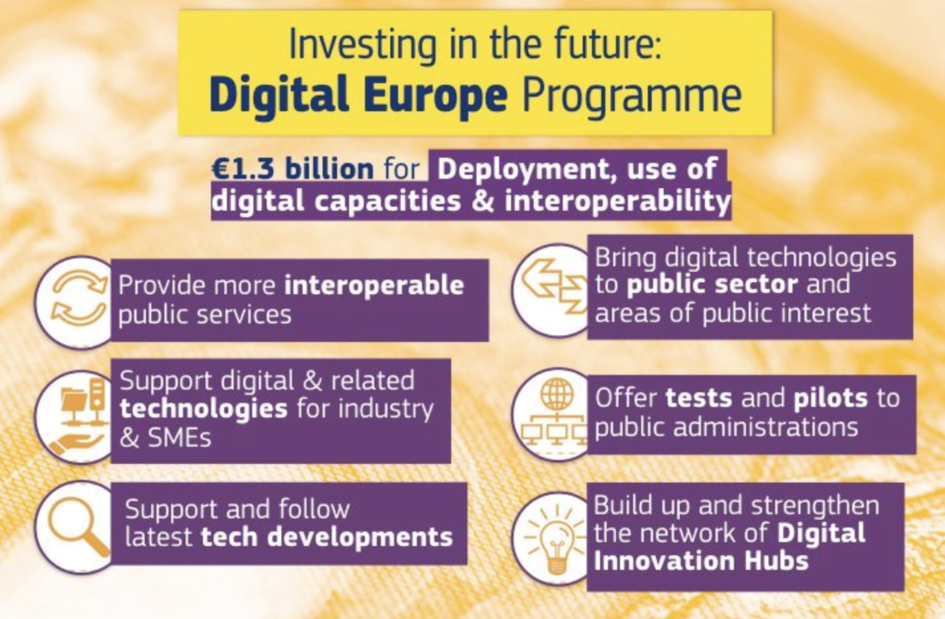
Digital Europe Program

Slide 9
Digital Europe Program
Horizon Europe focuses on innovative SMEs that develop new products.
Digital Europe must promote the widespread adoption of digital technologies
Notes:
Swiss-core

Slide 10
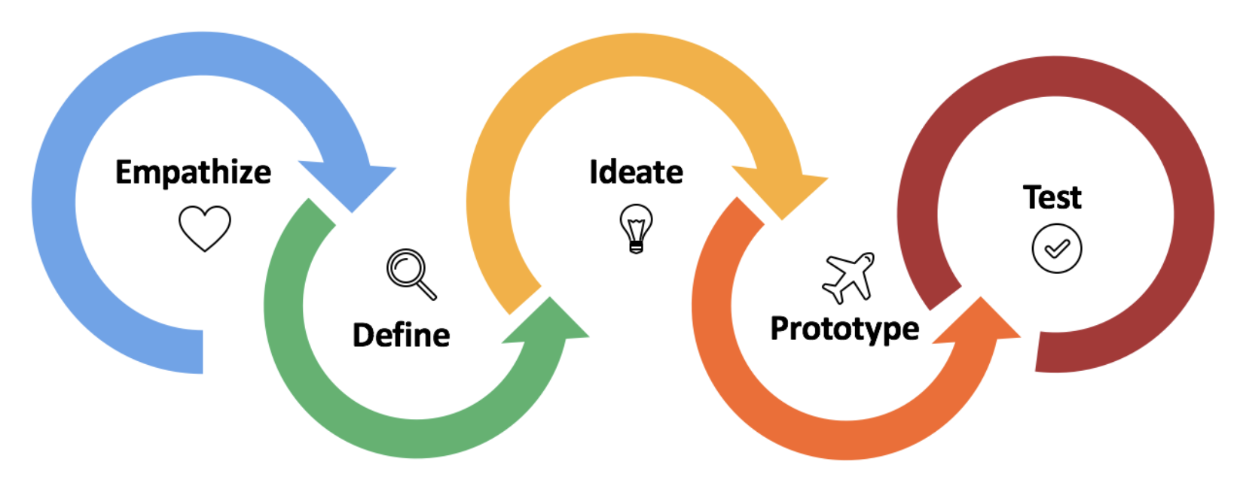
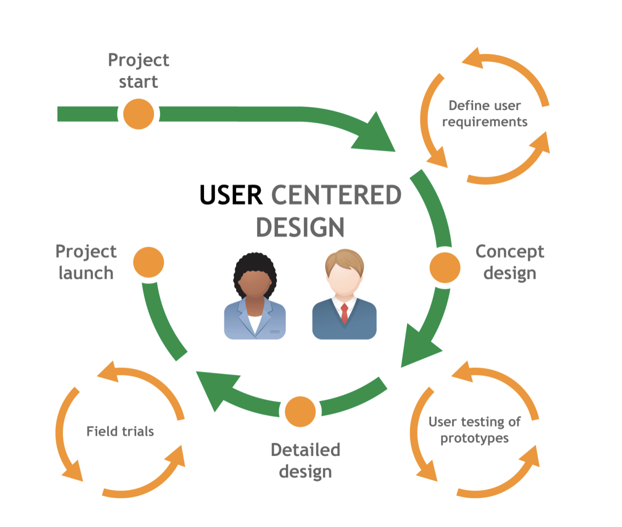
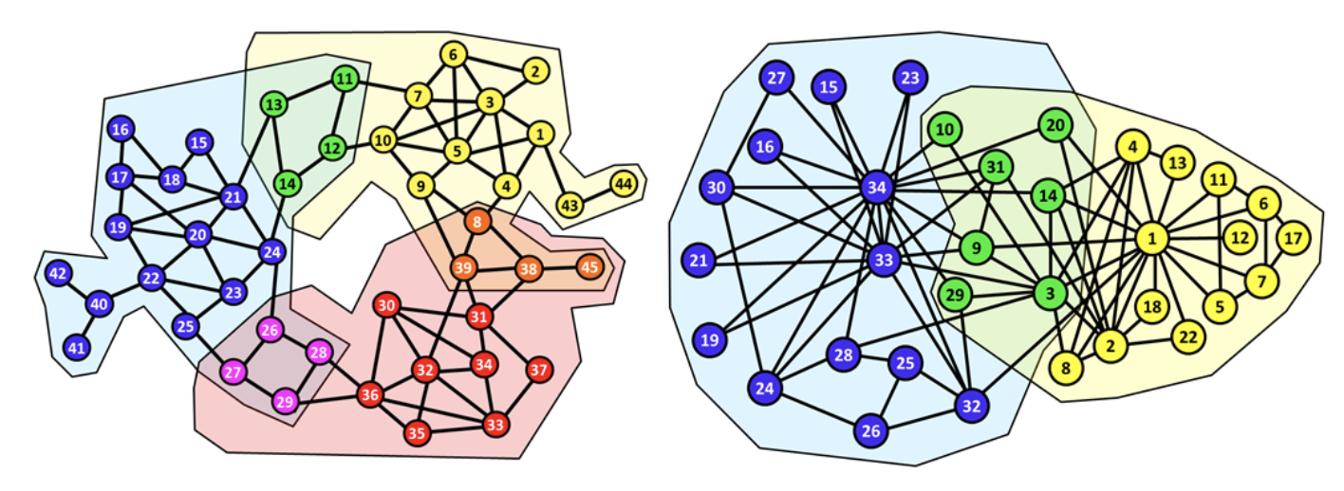
Impact through Ecosystem perspective

Slide 11
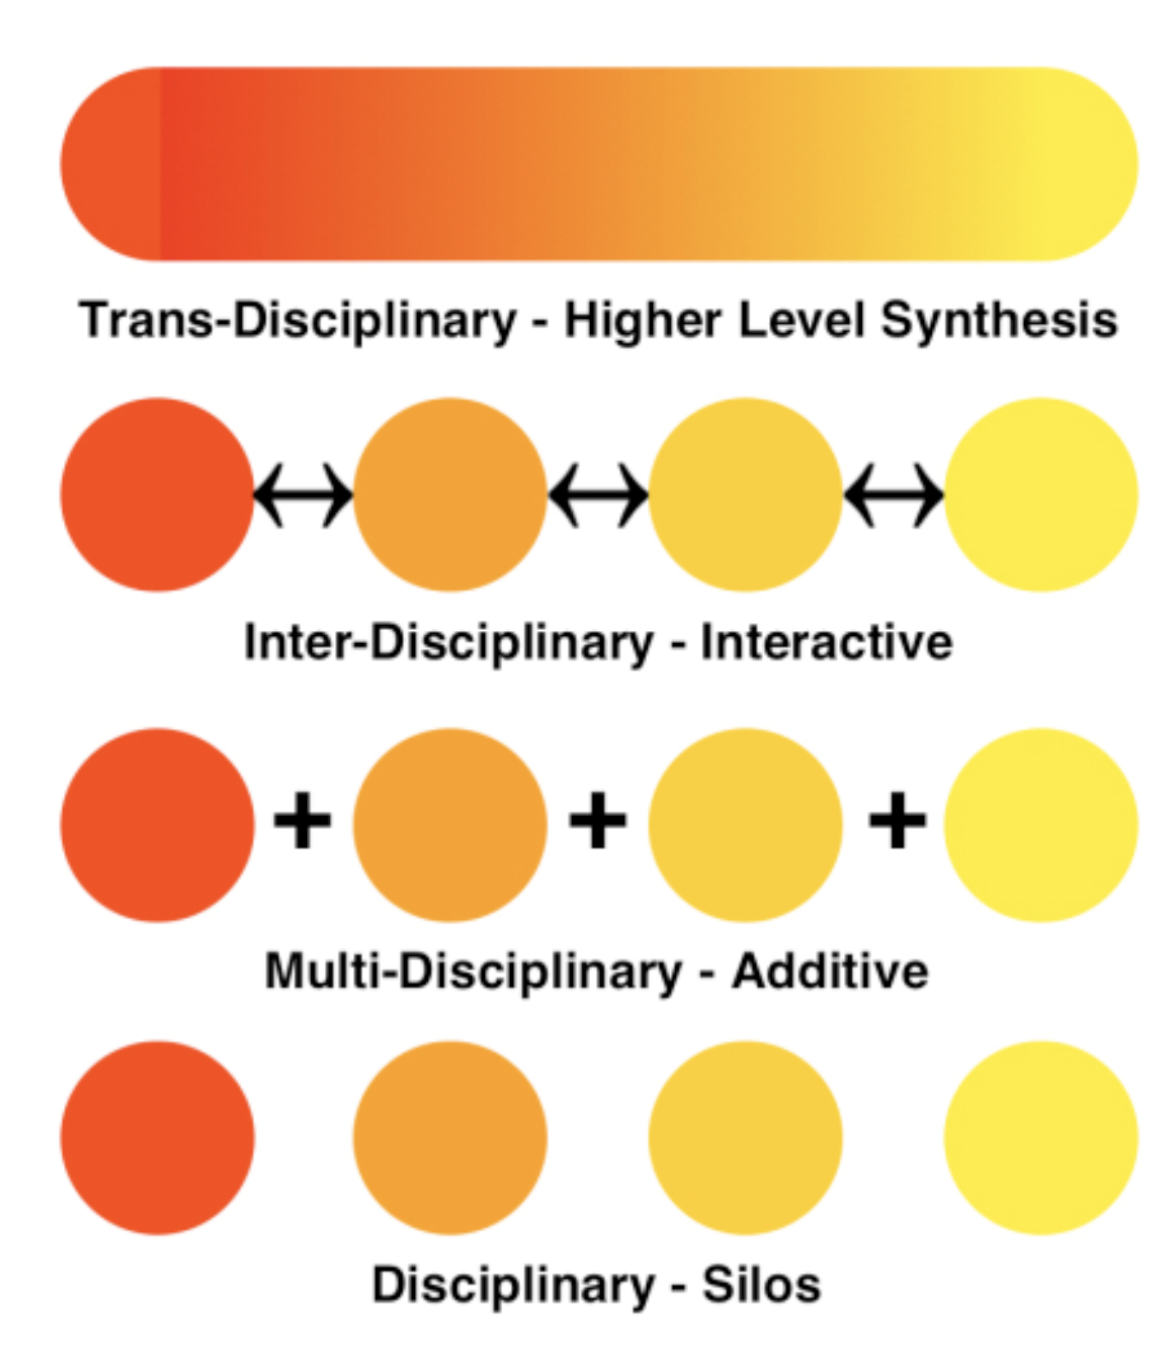
Disciplinary boundary crosser
RU main change needed

Slide 12
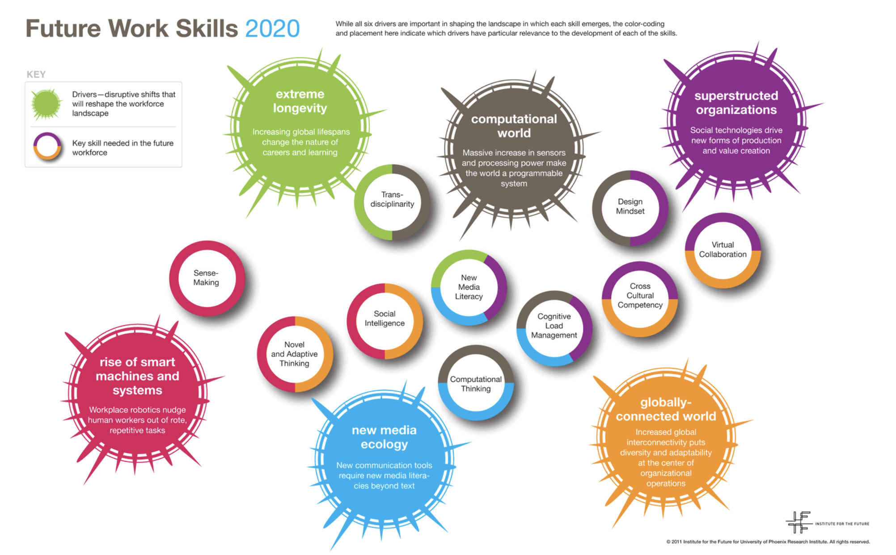
Skills for Impact in EU

Slide 13
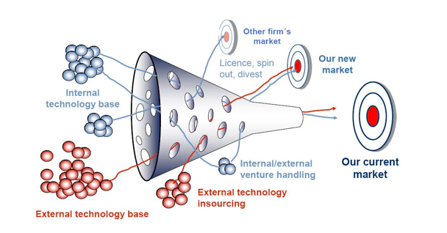
Open Innovation for Impact

Slide 14
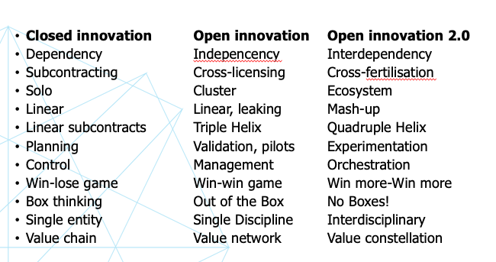
Innovation dimension in the Research University

Slide 15
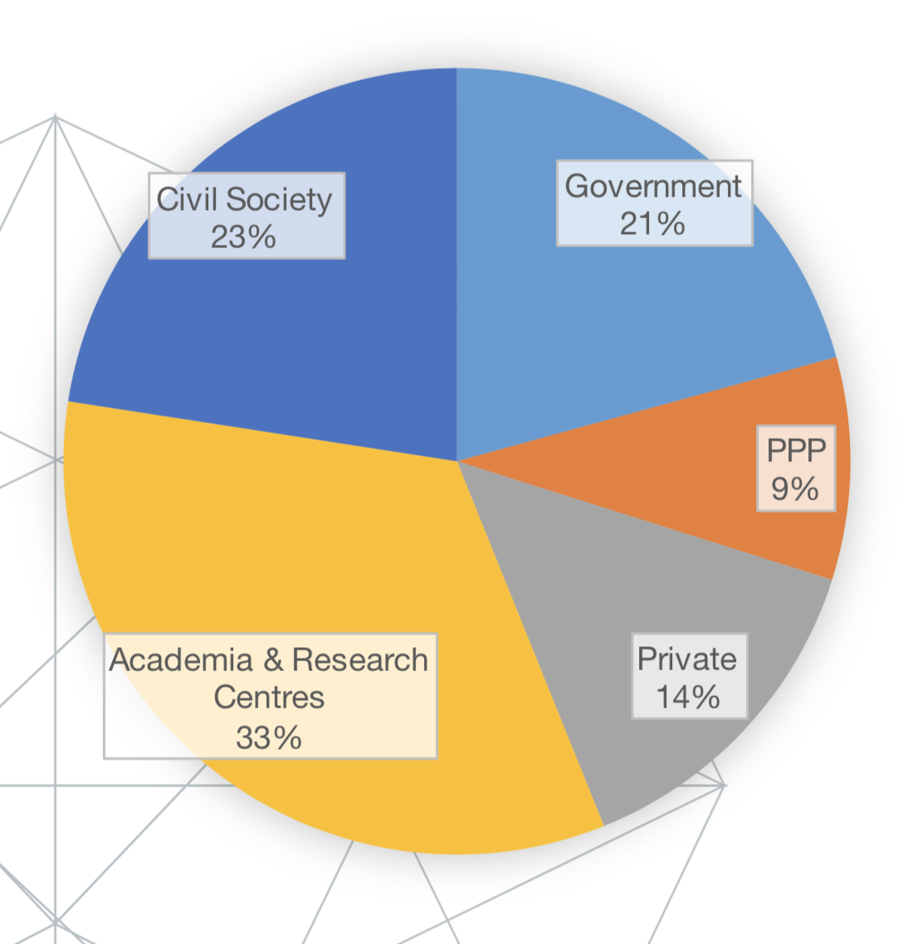
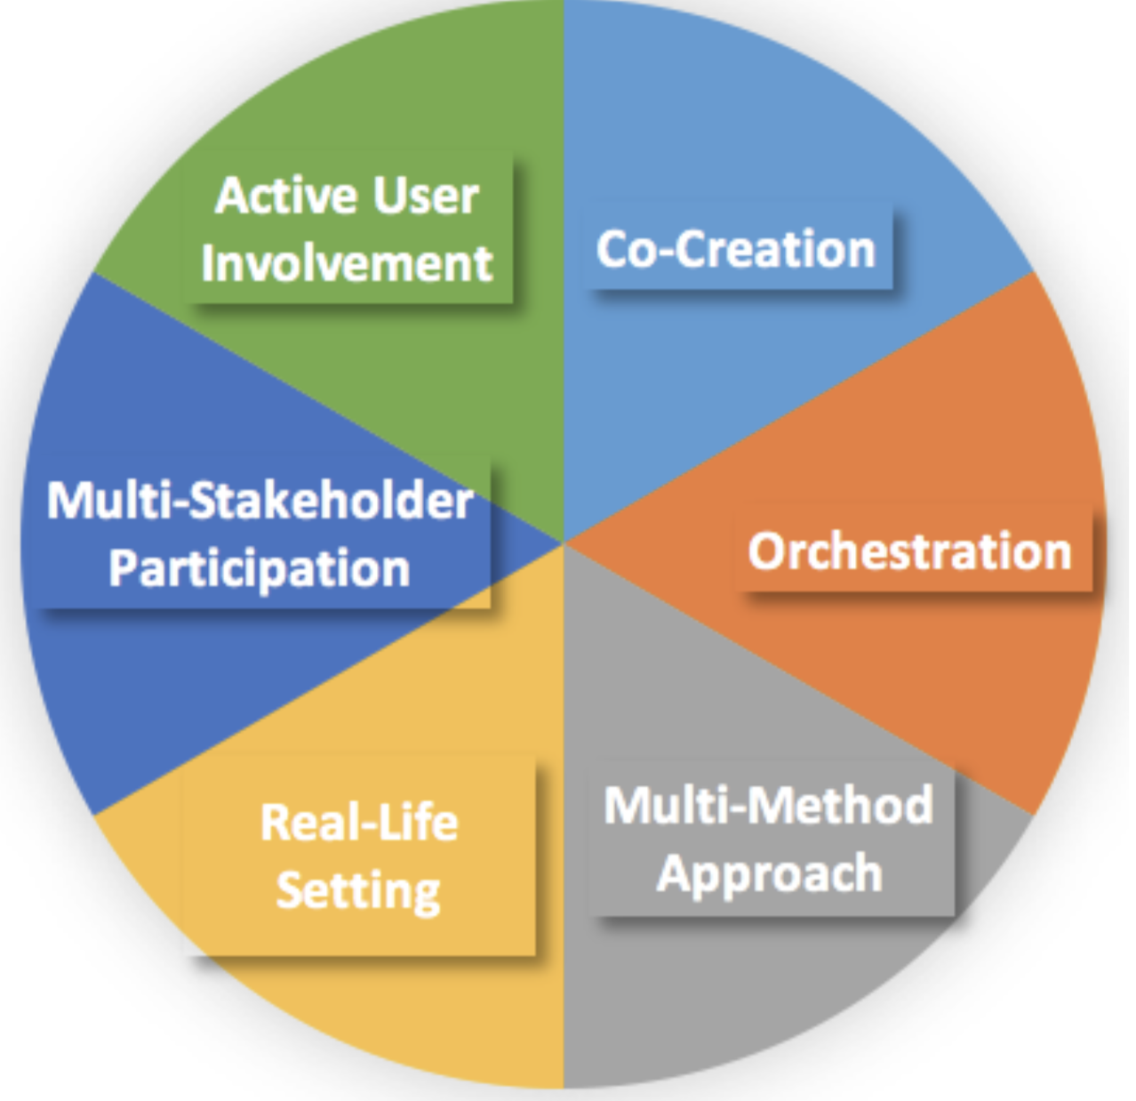
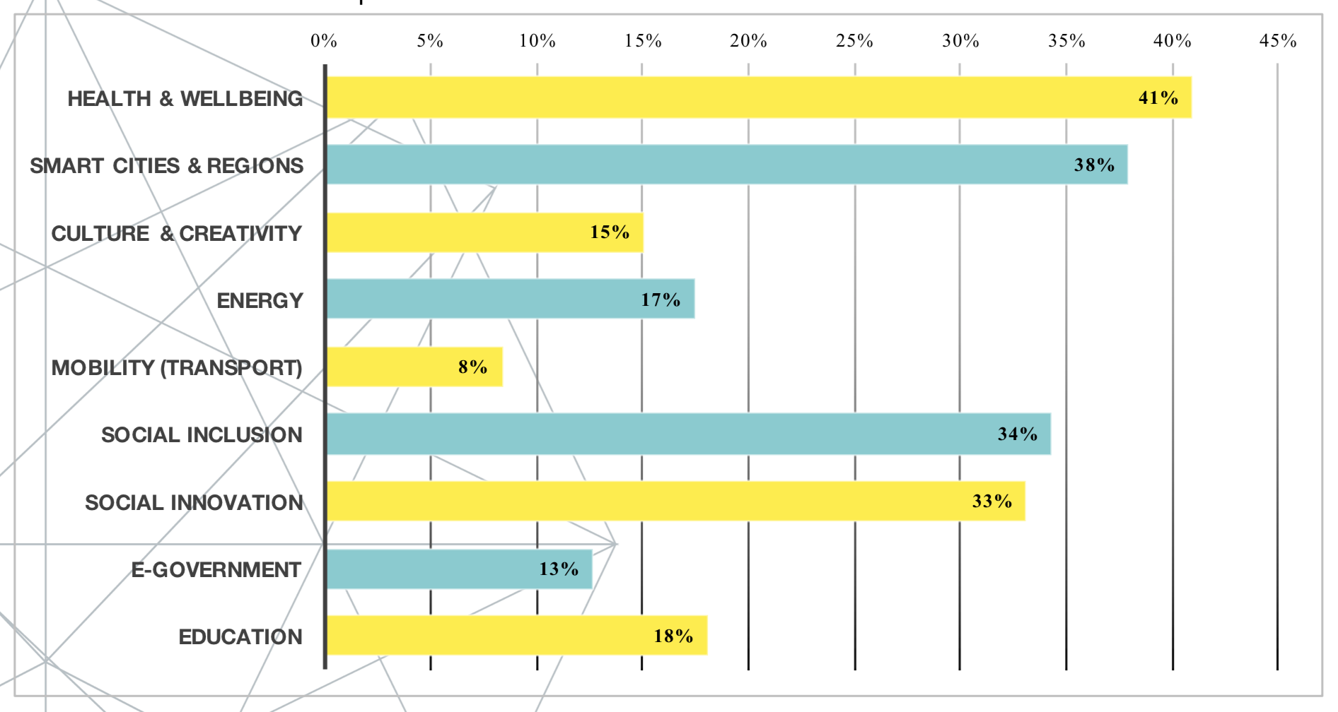
Ecosystems

Slide 16
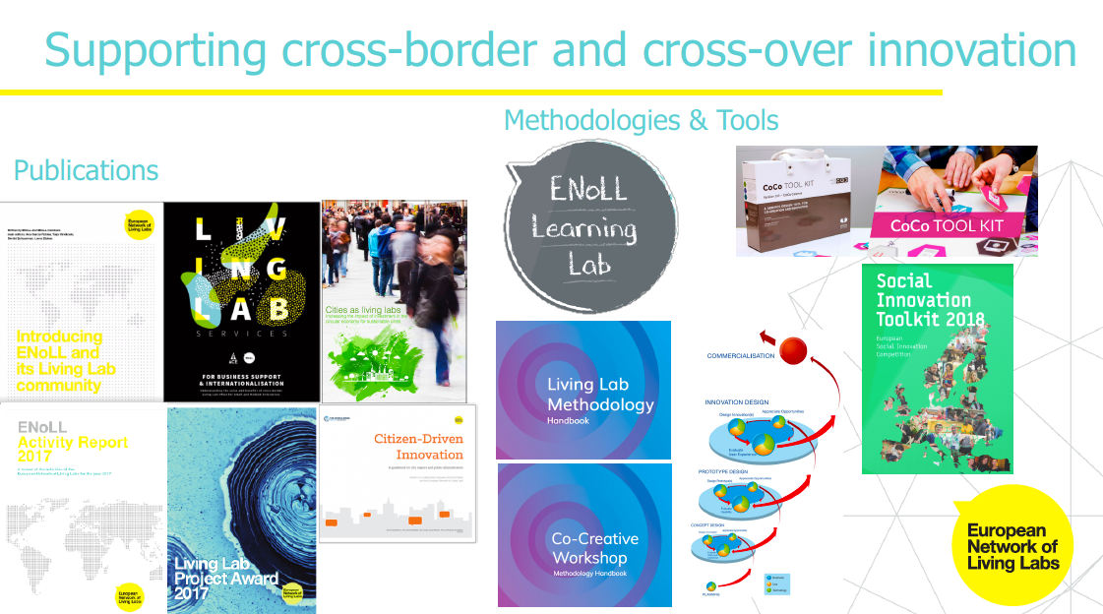
Read more? enoll.org

Slide 17
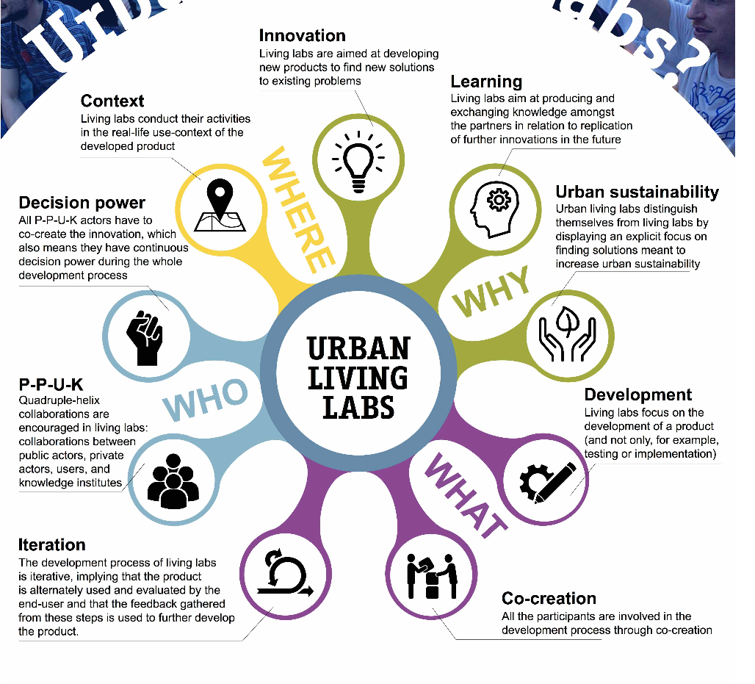

Slide 18
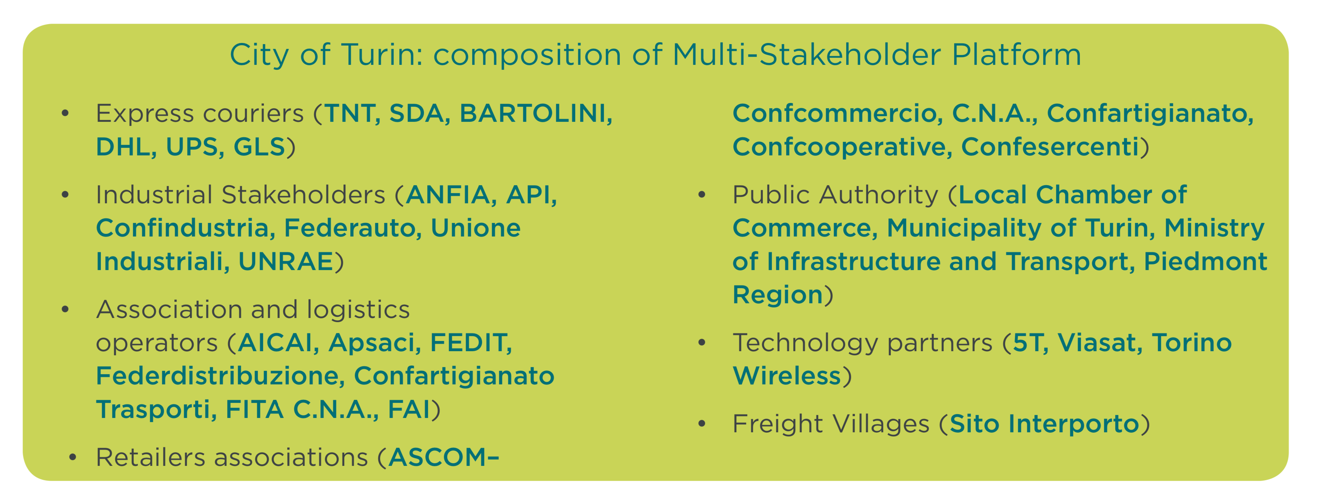
EU Consortia for Regional Impact

Slide 19
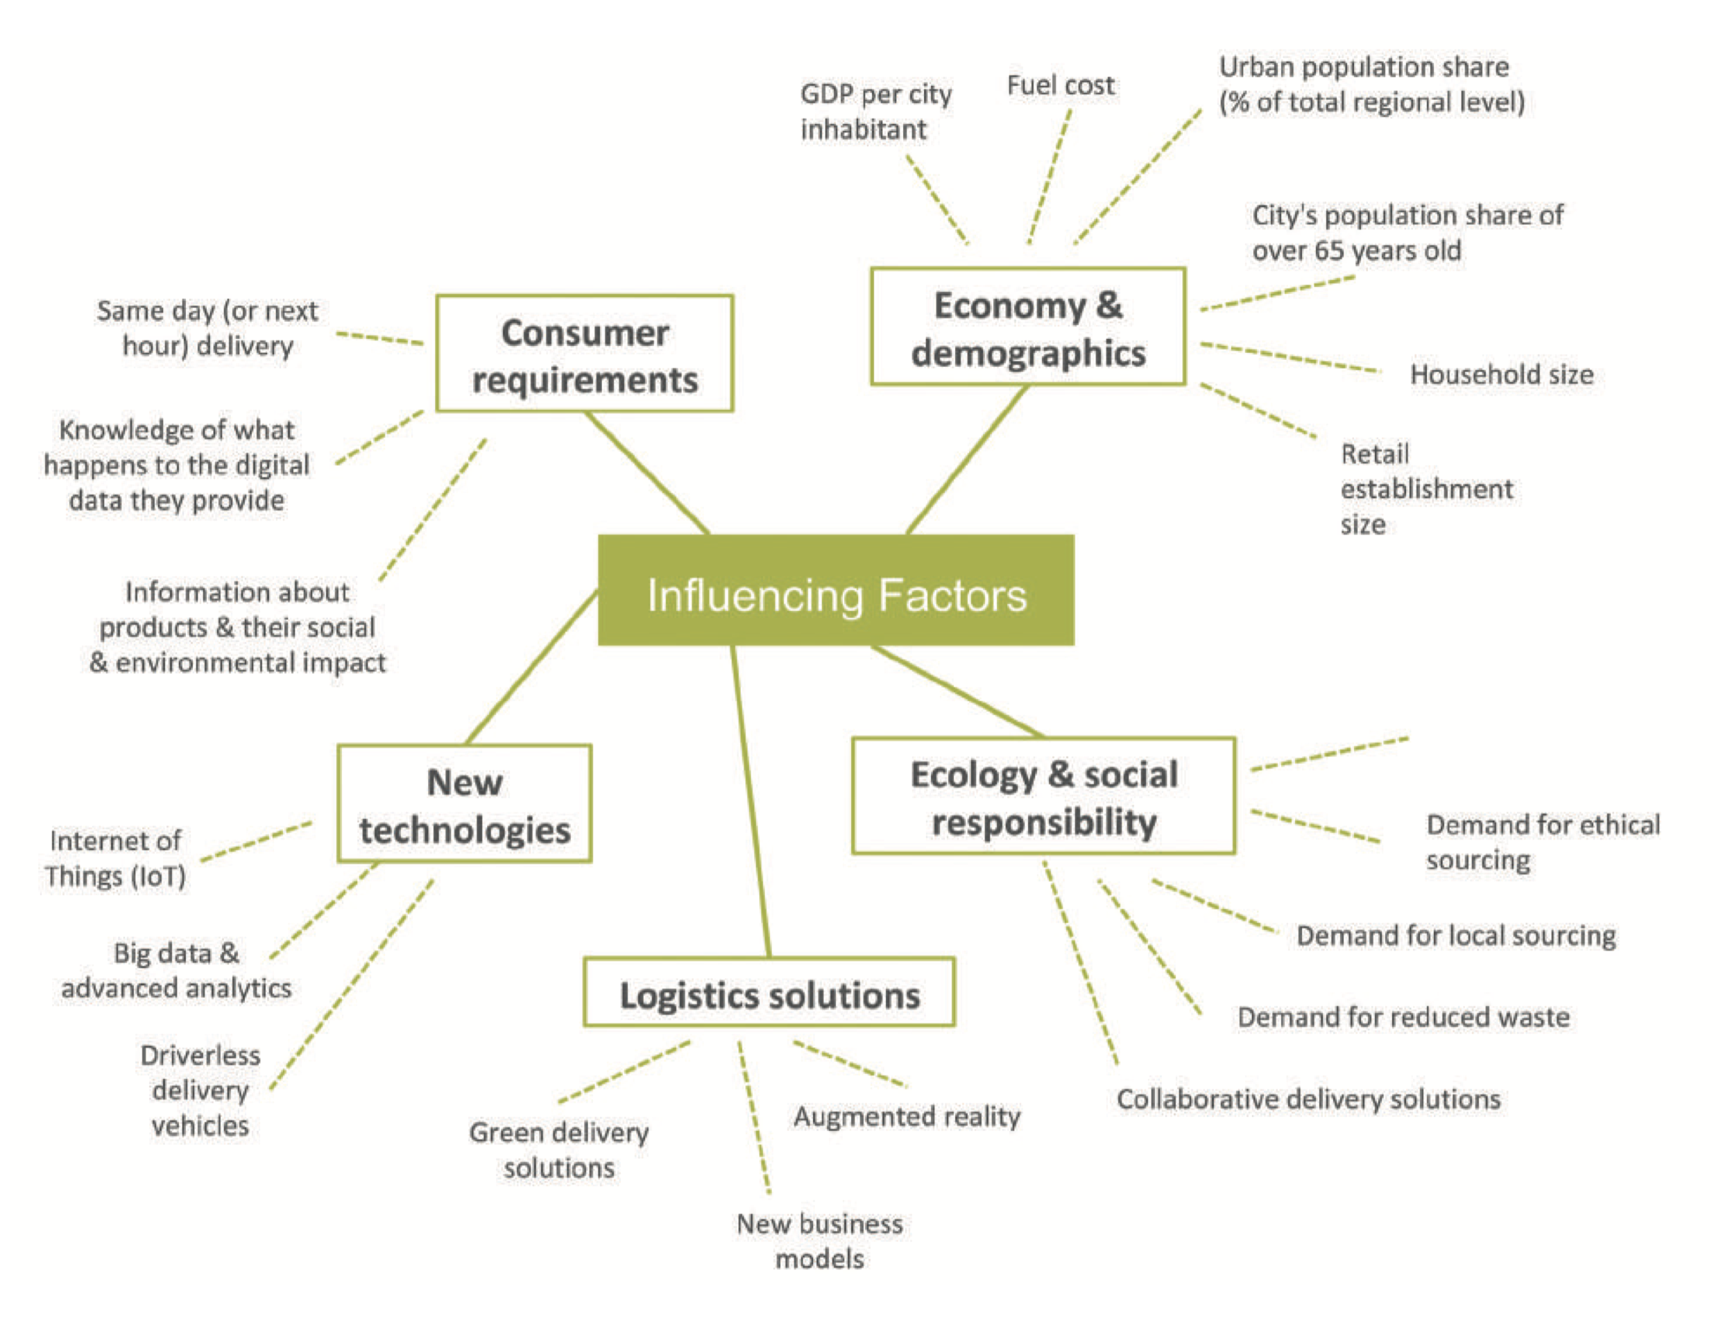
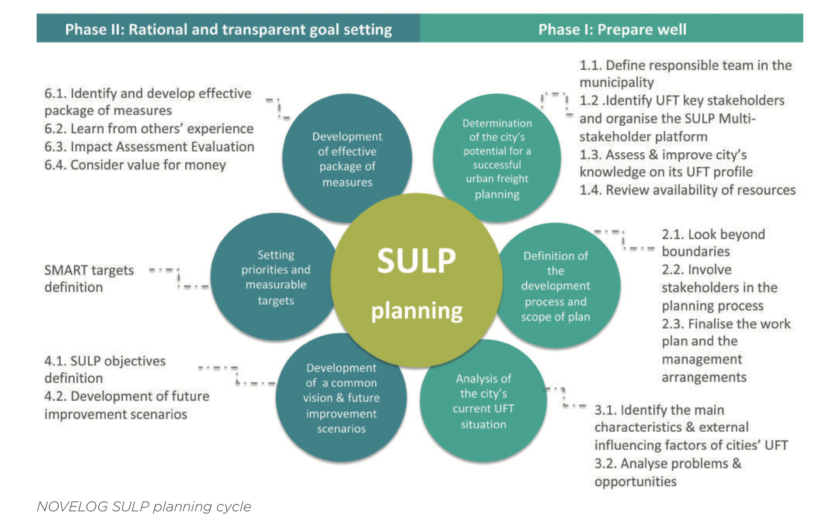
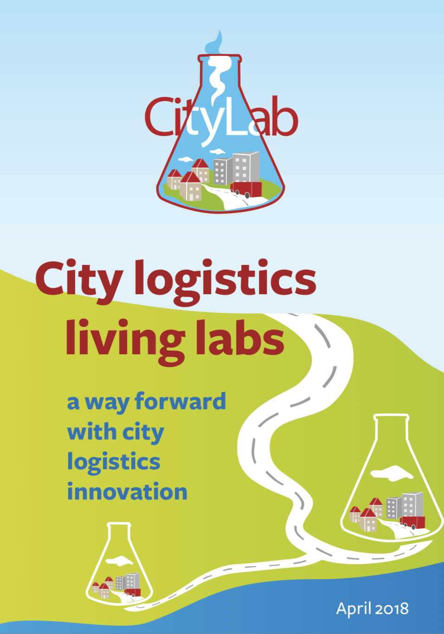
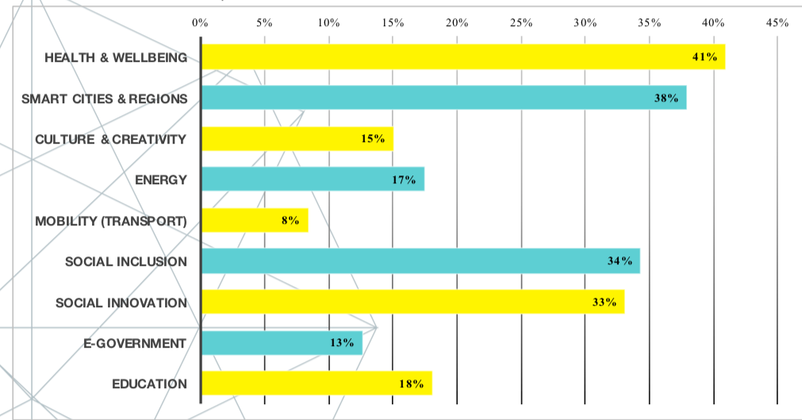
Learn from City Lab, Novelog & European Network of Living Labs
Living labs / MSP
Integrating factors
43 % vs 8% only! No transnational learning, like Health Livings Labs

Slide 20
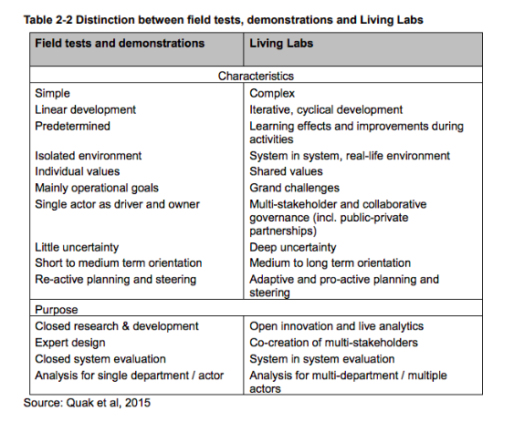
Bigger transitions towards Impact

Slide 21
https://www.linkedin.com/in/danielledeboer/
INNOFIUS specialises in strategy, design and implementation of innovation projects
(often cross-sectoral open innovation). INNOFIUS builds multi-stakeholder partnerships & ecosystems (quadruple/quintuple helix and Living Labs) needed for bigger societal challenges.
The company supports 'cross-overs' in edu-tech, health-tech, green-tech, sports-sustainability, logistics-smart cities etc. Coaches and professionalizes innovation managers and leaders for systemic change, boundary crossing and evidence-based implementation & innovation monitoring.
INNOFIUS also advises in European funding and smart financial engineering schemes usually for innovative multi-stakeholder Research & Innovation projects.

